Slide 1
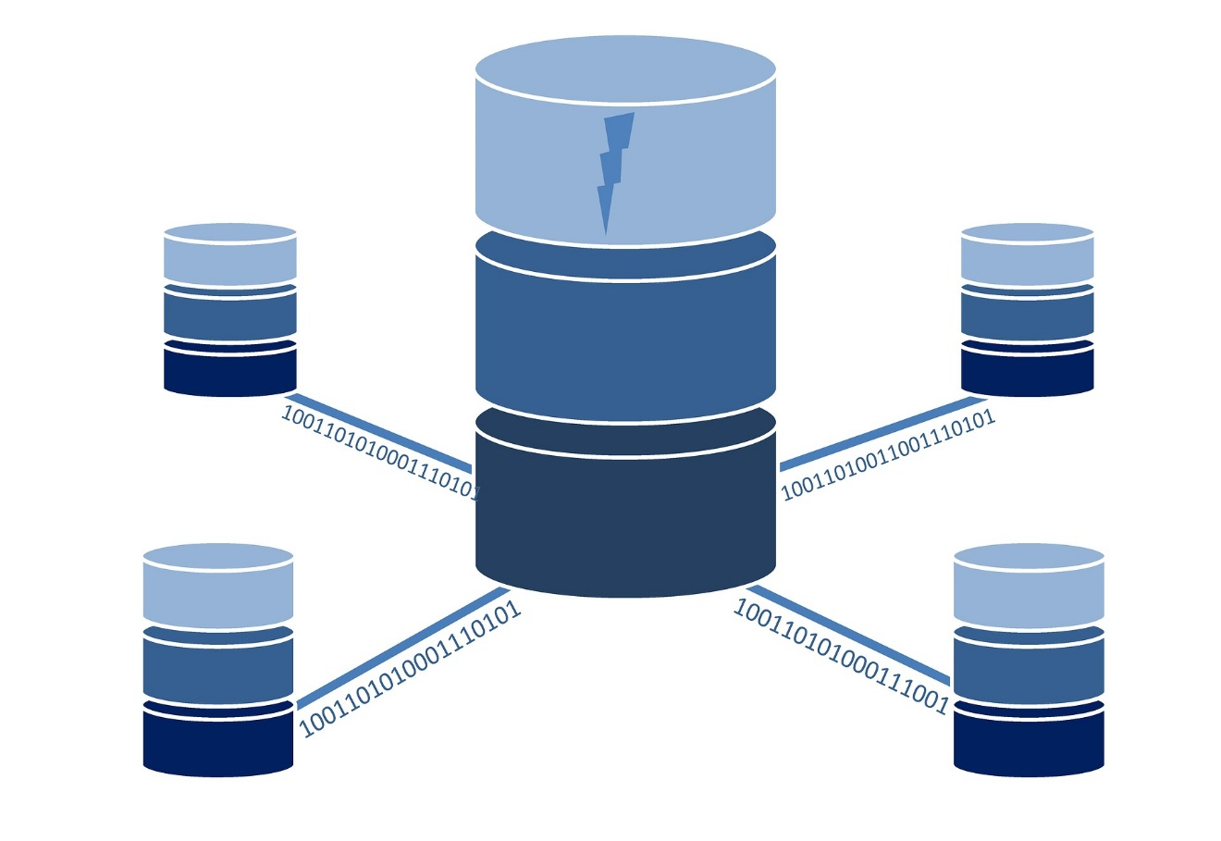
SPATIAL DATABASE PROJECT CHICAGO DATASET
BY: SAHIL SHAH
STUDENT ID: 21251000

Slide 2
Abstract
Crime is something which we can’t avoid.
In this project we analyzed Chicago Crimes and Chicago School Safety Scores.
Minimize the crime.
Relation between school safety score and crimes in particular locations.

Slide 3
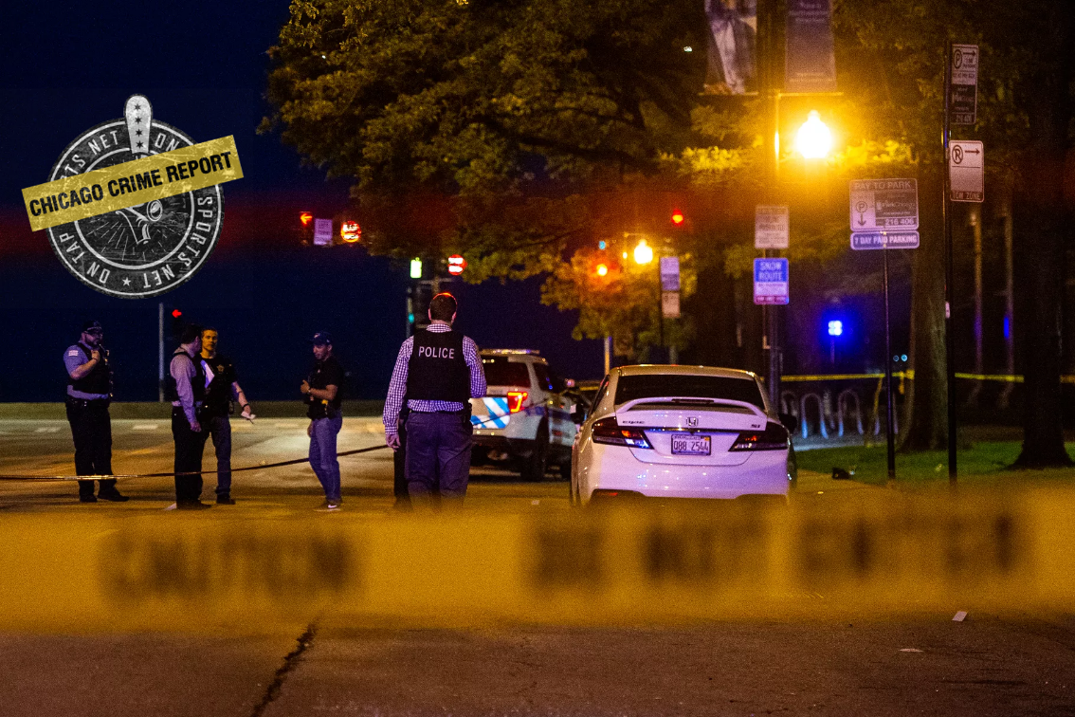
Introduction
Crimes are one of the most biggest problem.
Crimes information known to everyone.
Also help to police to find the pattern of crimes.
General information about schools safety.

Slide 4
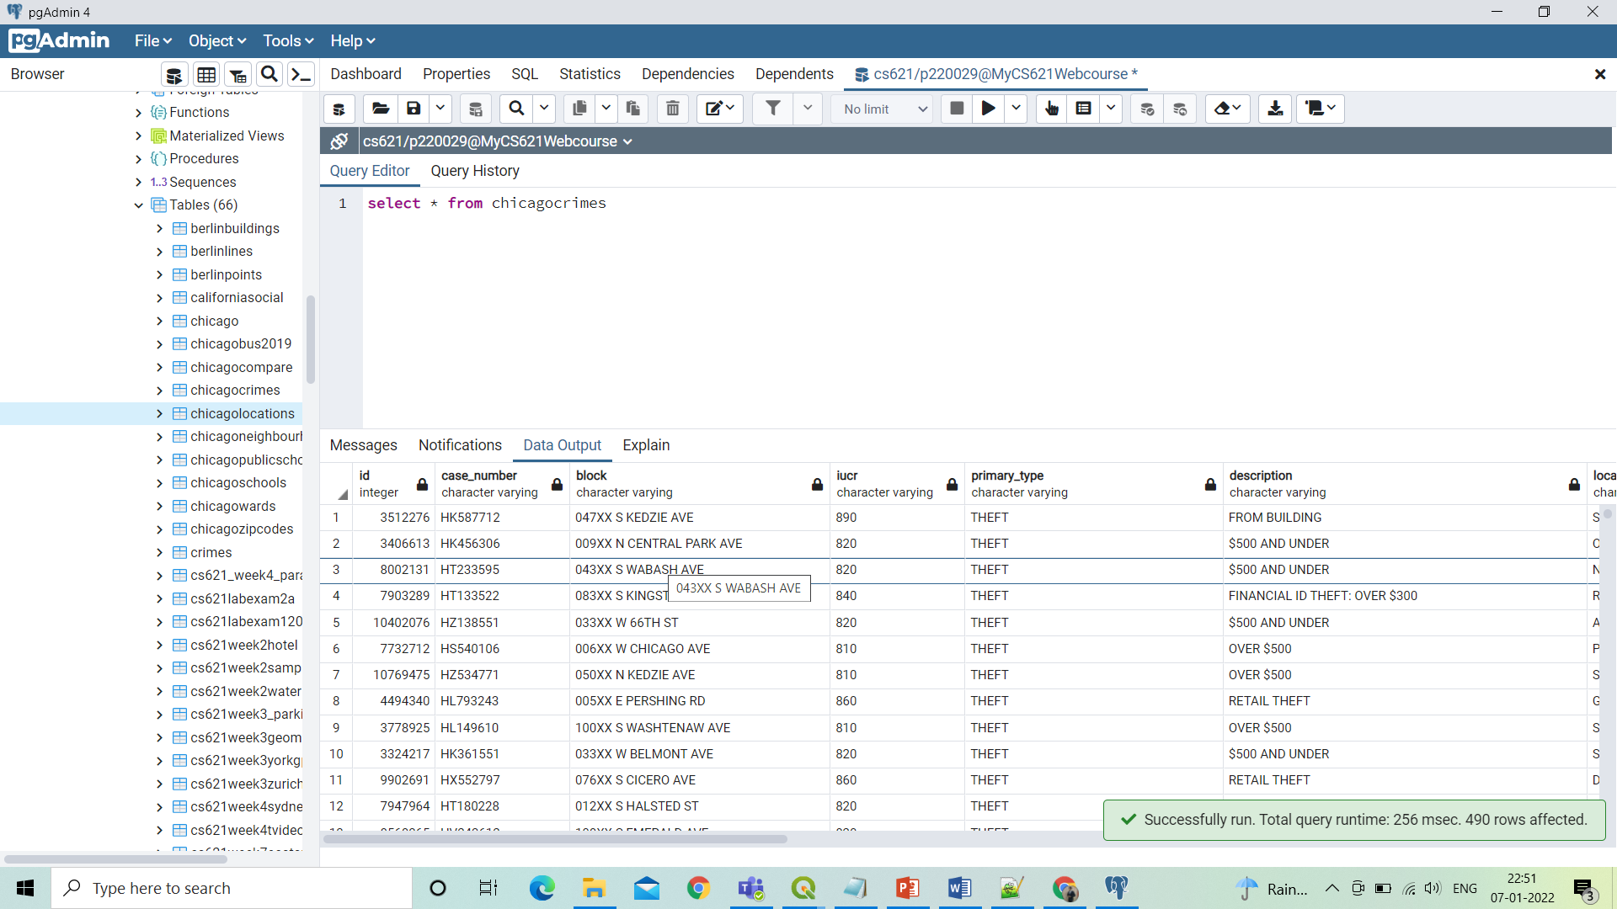
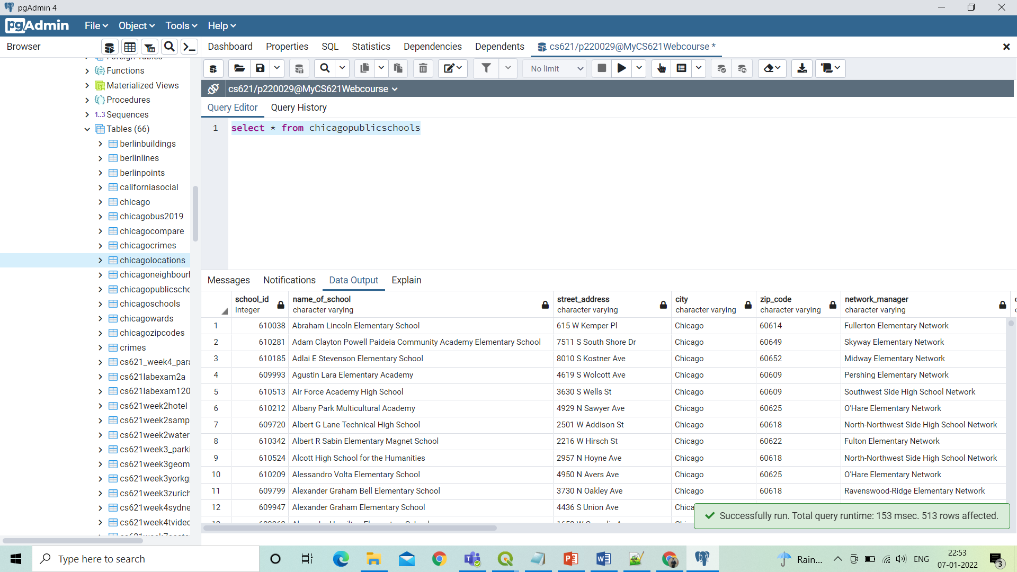
Chicago Crime Dataset
Chicago Public School Dataset

Slide 5
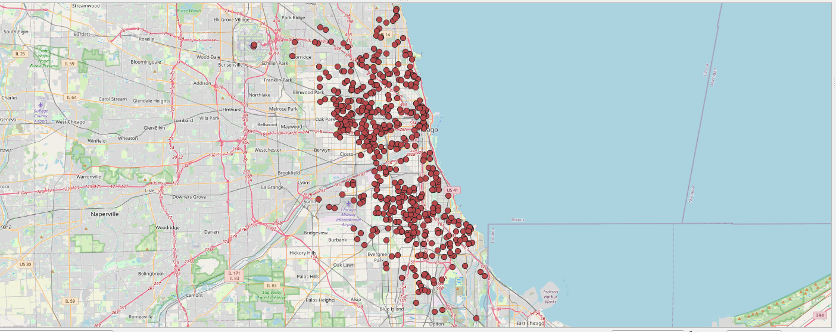
Chicago Crime Points

Slide 6
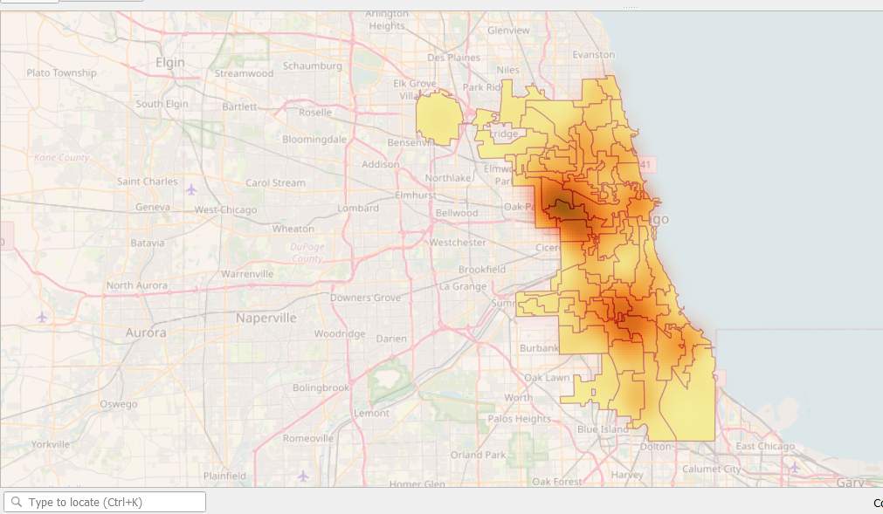
Heatmap for Chicago Crime dataset

Slide 7
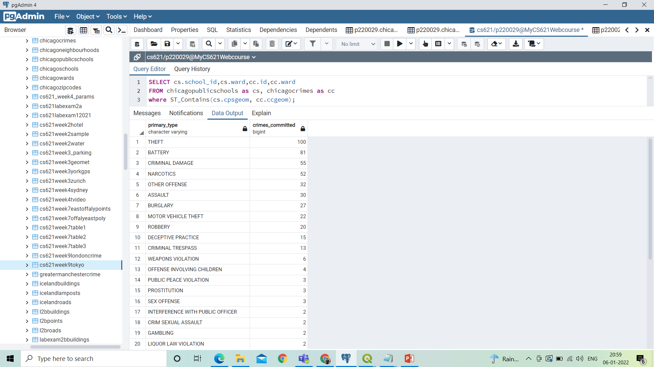
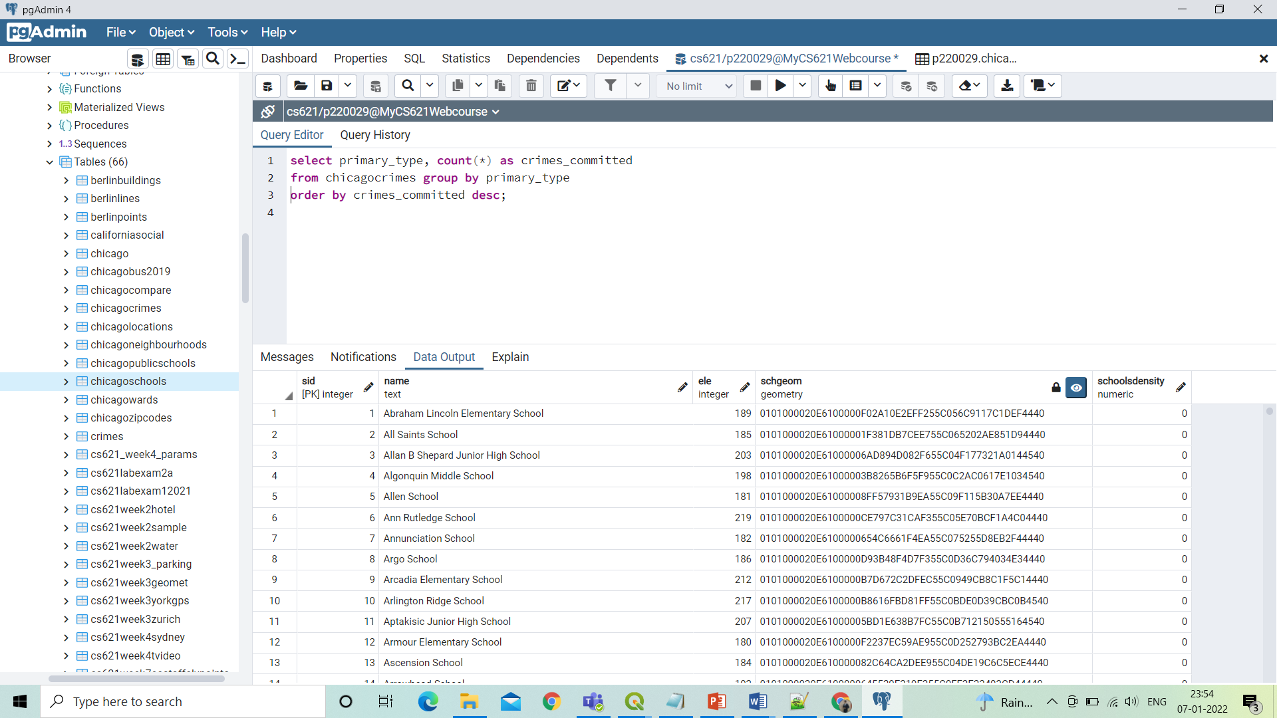
Crimes committed.
So there are 34 different kind of crimes committed in Chicago.

Slide 8
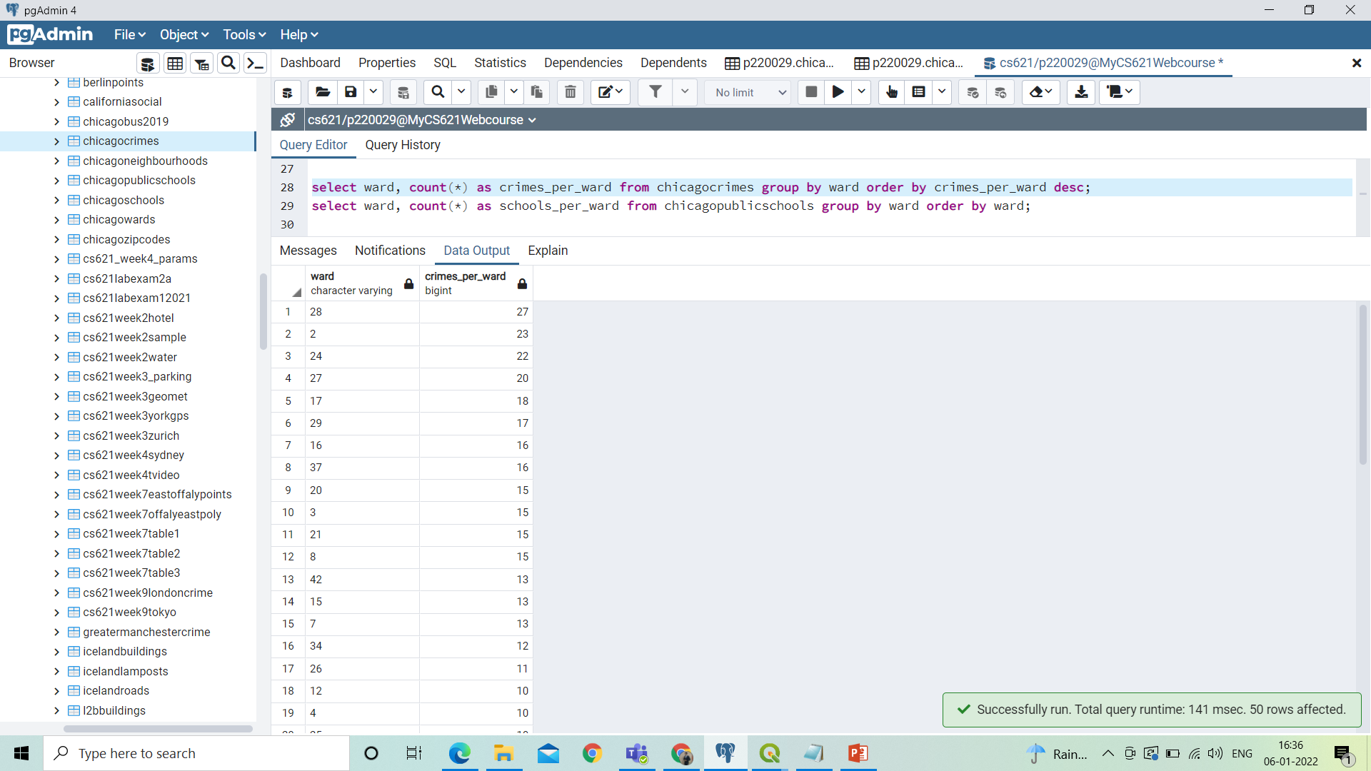
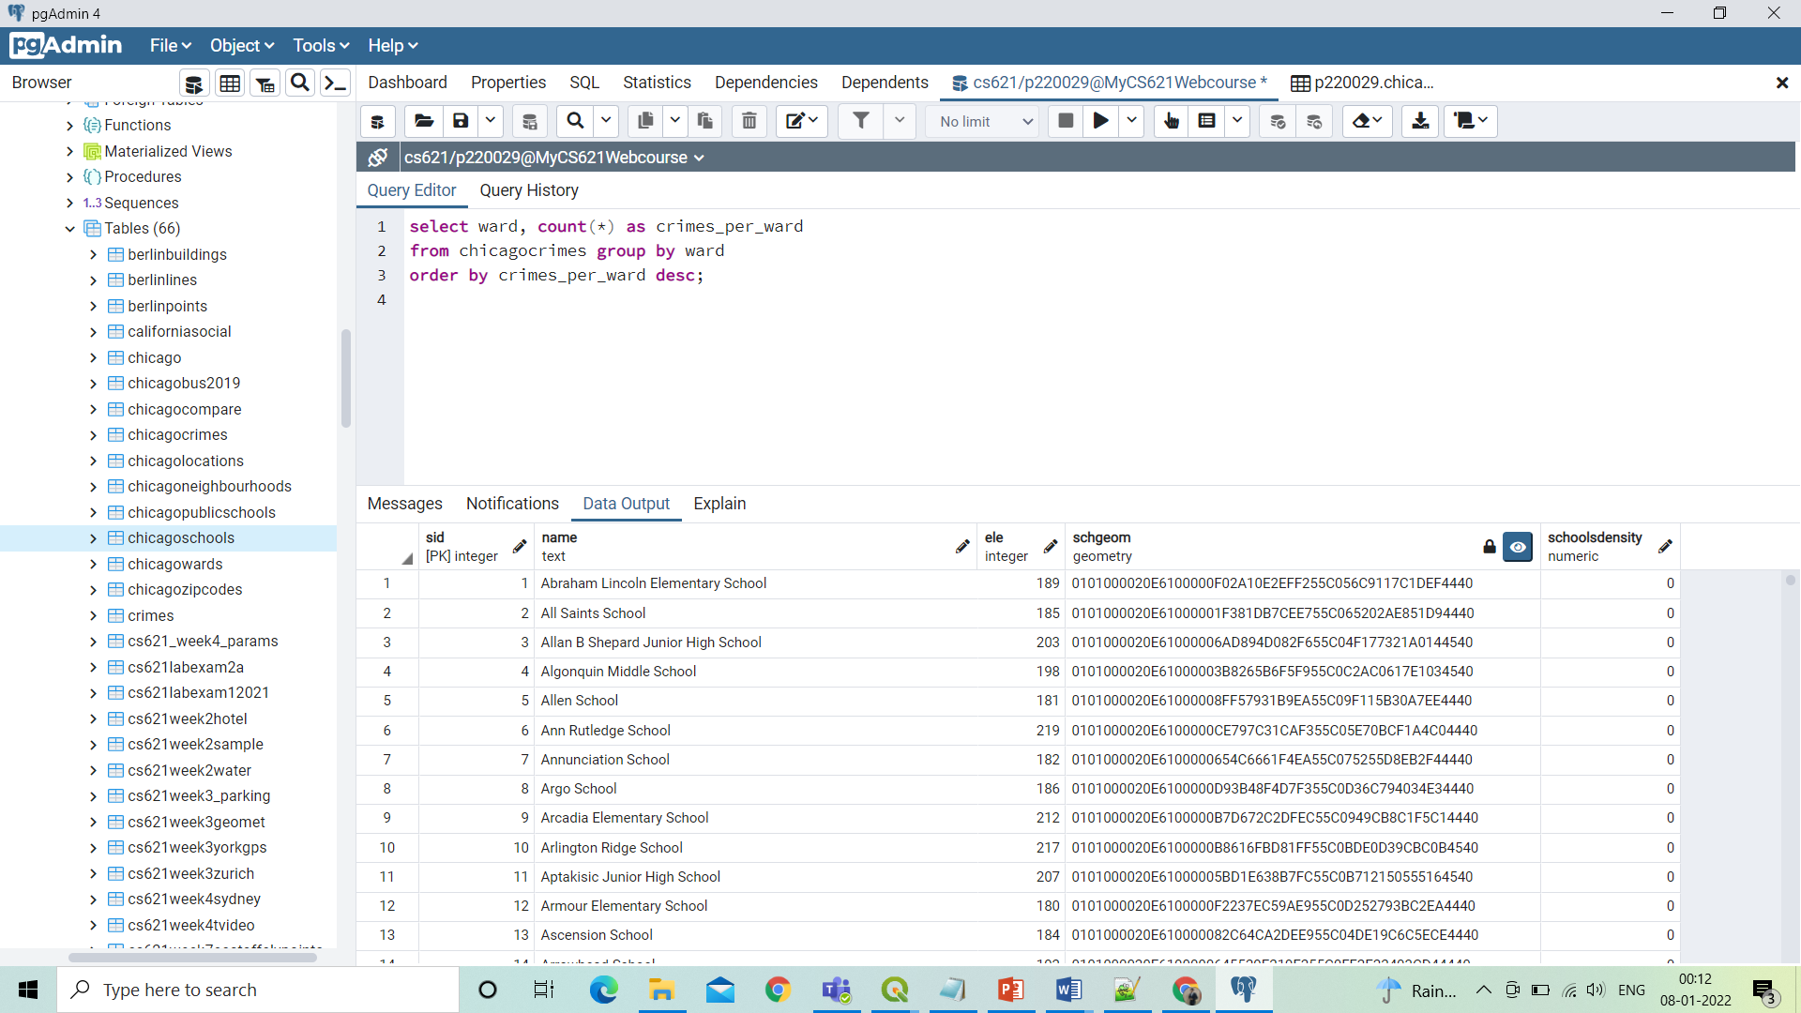
Number of crimes per ward.
So there are total 50 wards, in which different kind of crimes took place.

Slide 9
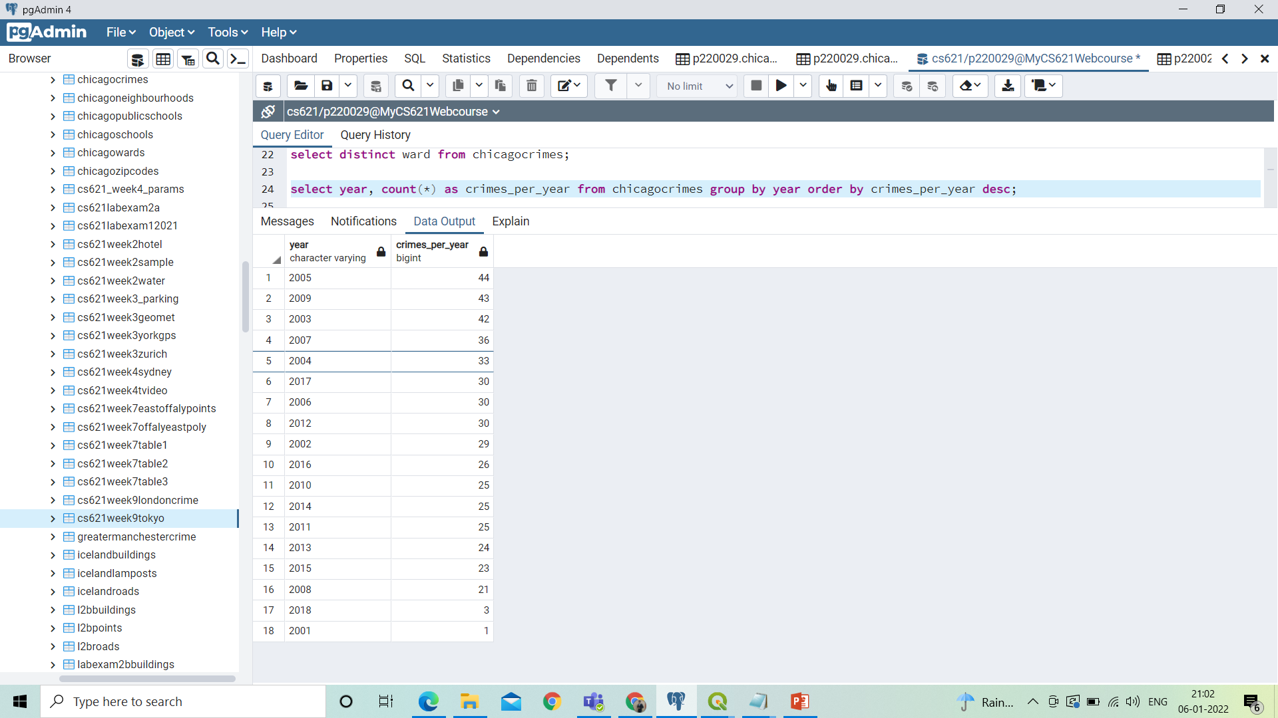

Crimes per year
This dataset contains the record from 2001 to 2018.

Slide 10
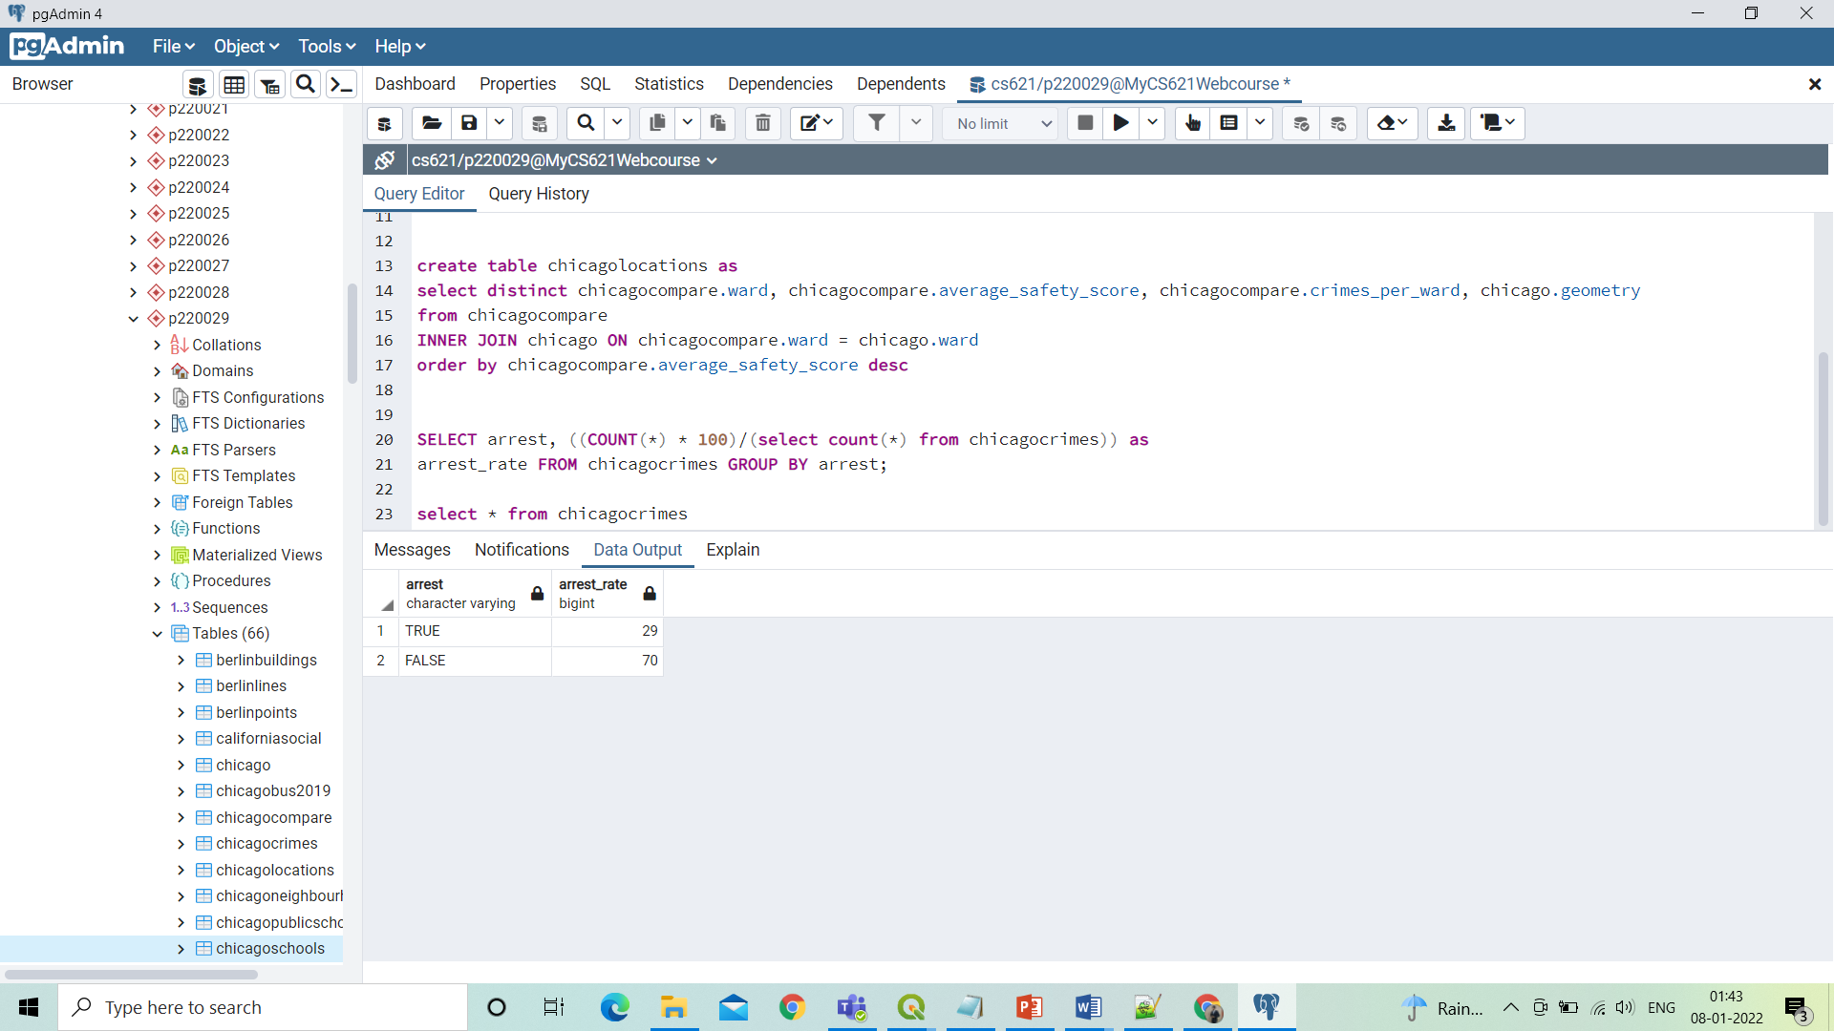

Arrest Rate
Arrest rate displays i.e 29% of criminals are arrested and 70% criminals are not arrested.

Slide 11
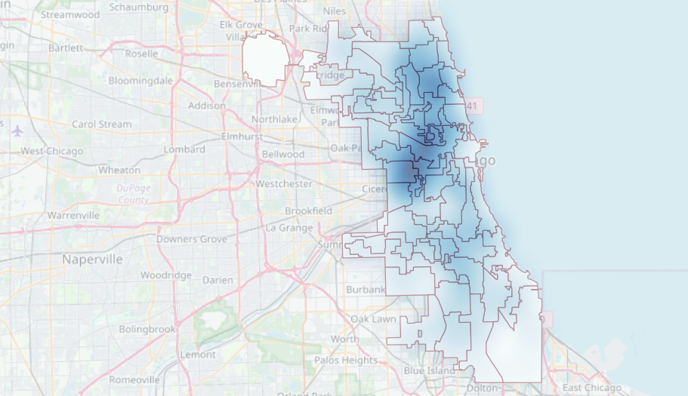
Heatmap from Chicago Public Schools

Slide 12
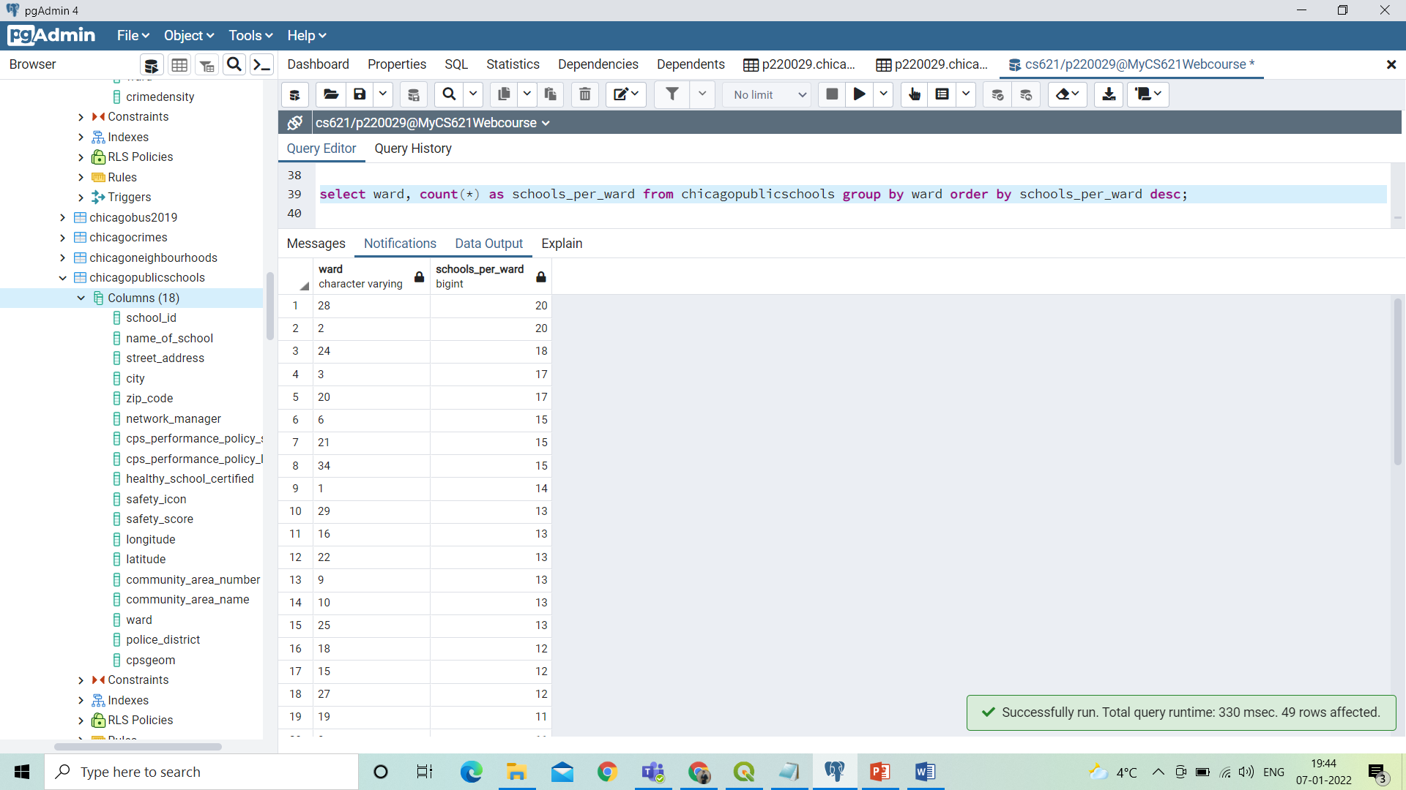

Schools per ward
So there are total 50 wards in our dataset.

Slide 13
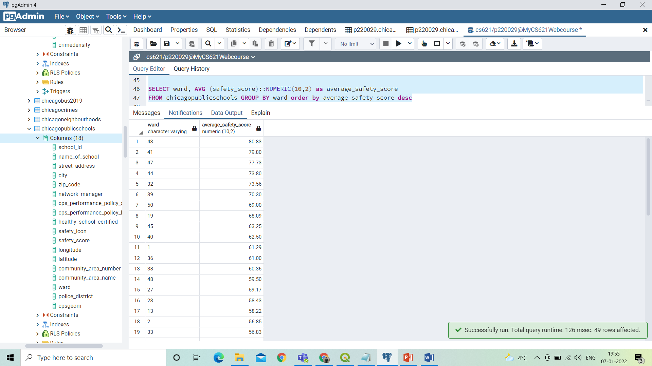
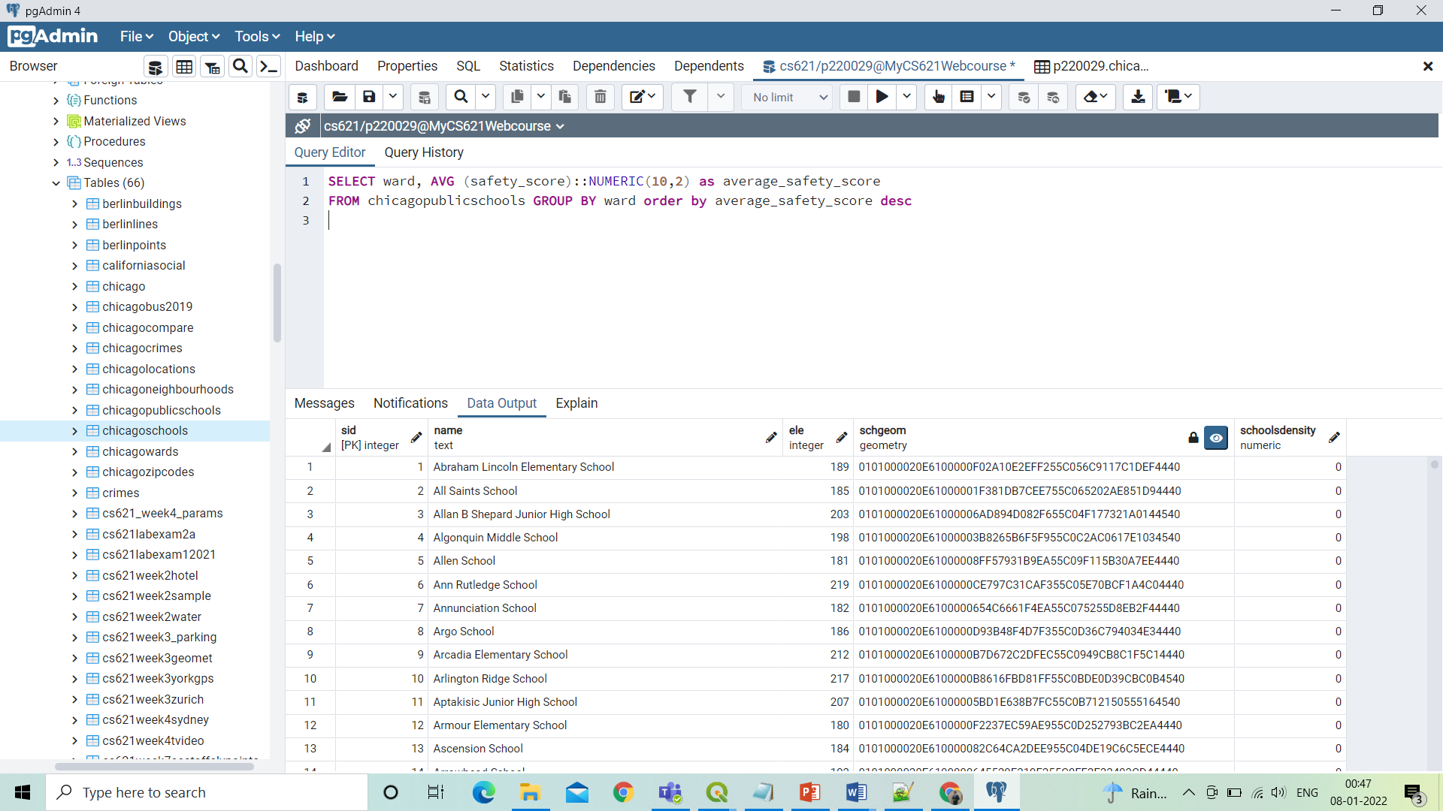
Average safety score for each ward
Safety Scores given by the government is out of 100.

Slide 14
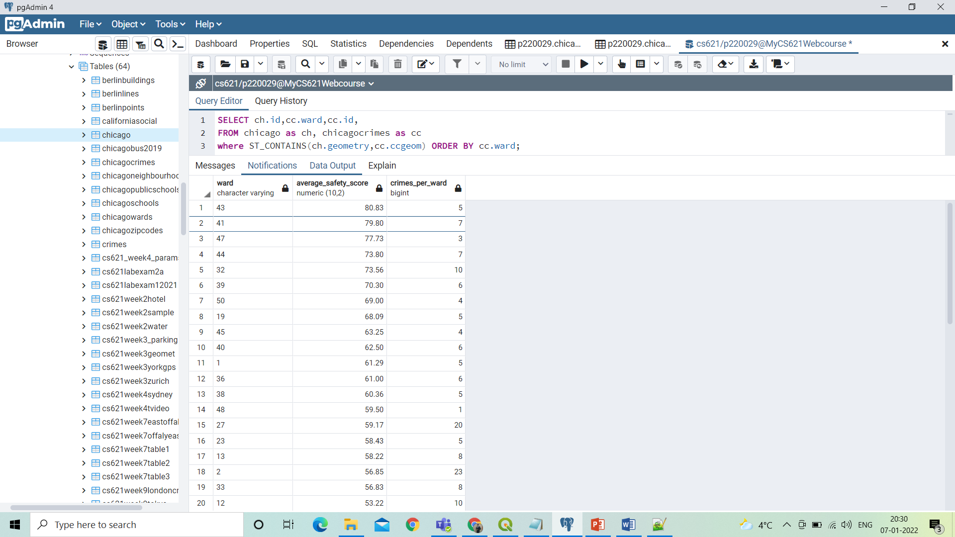
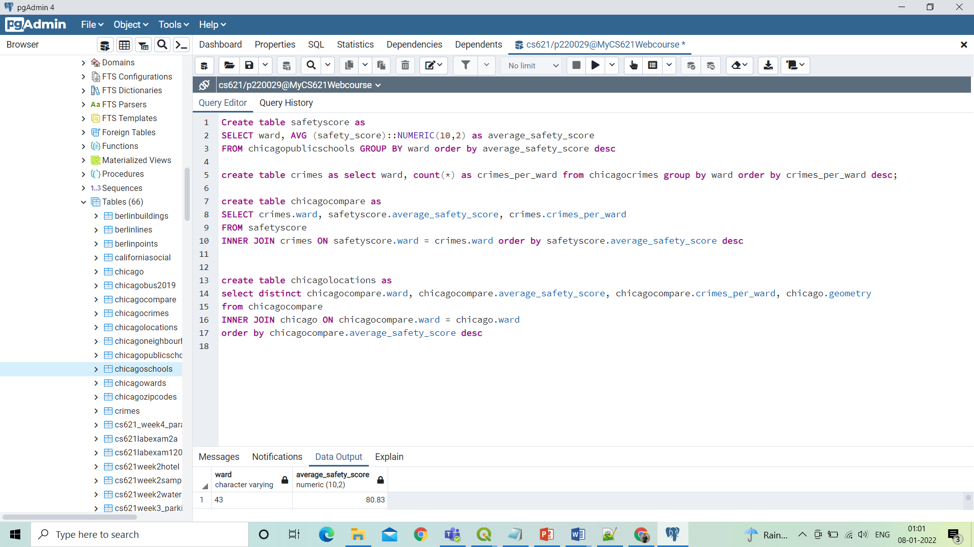
So here we have compared the average safety score per ward of schools and crimes per ward.

Slide 15
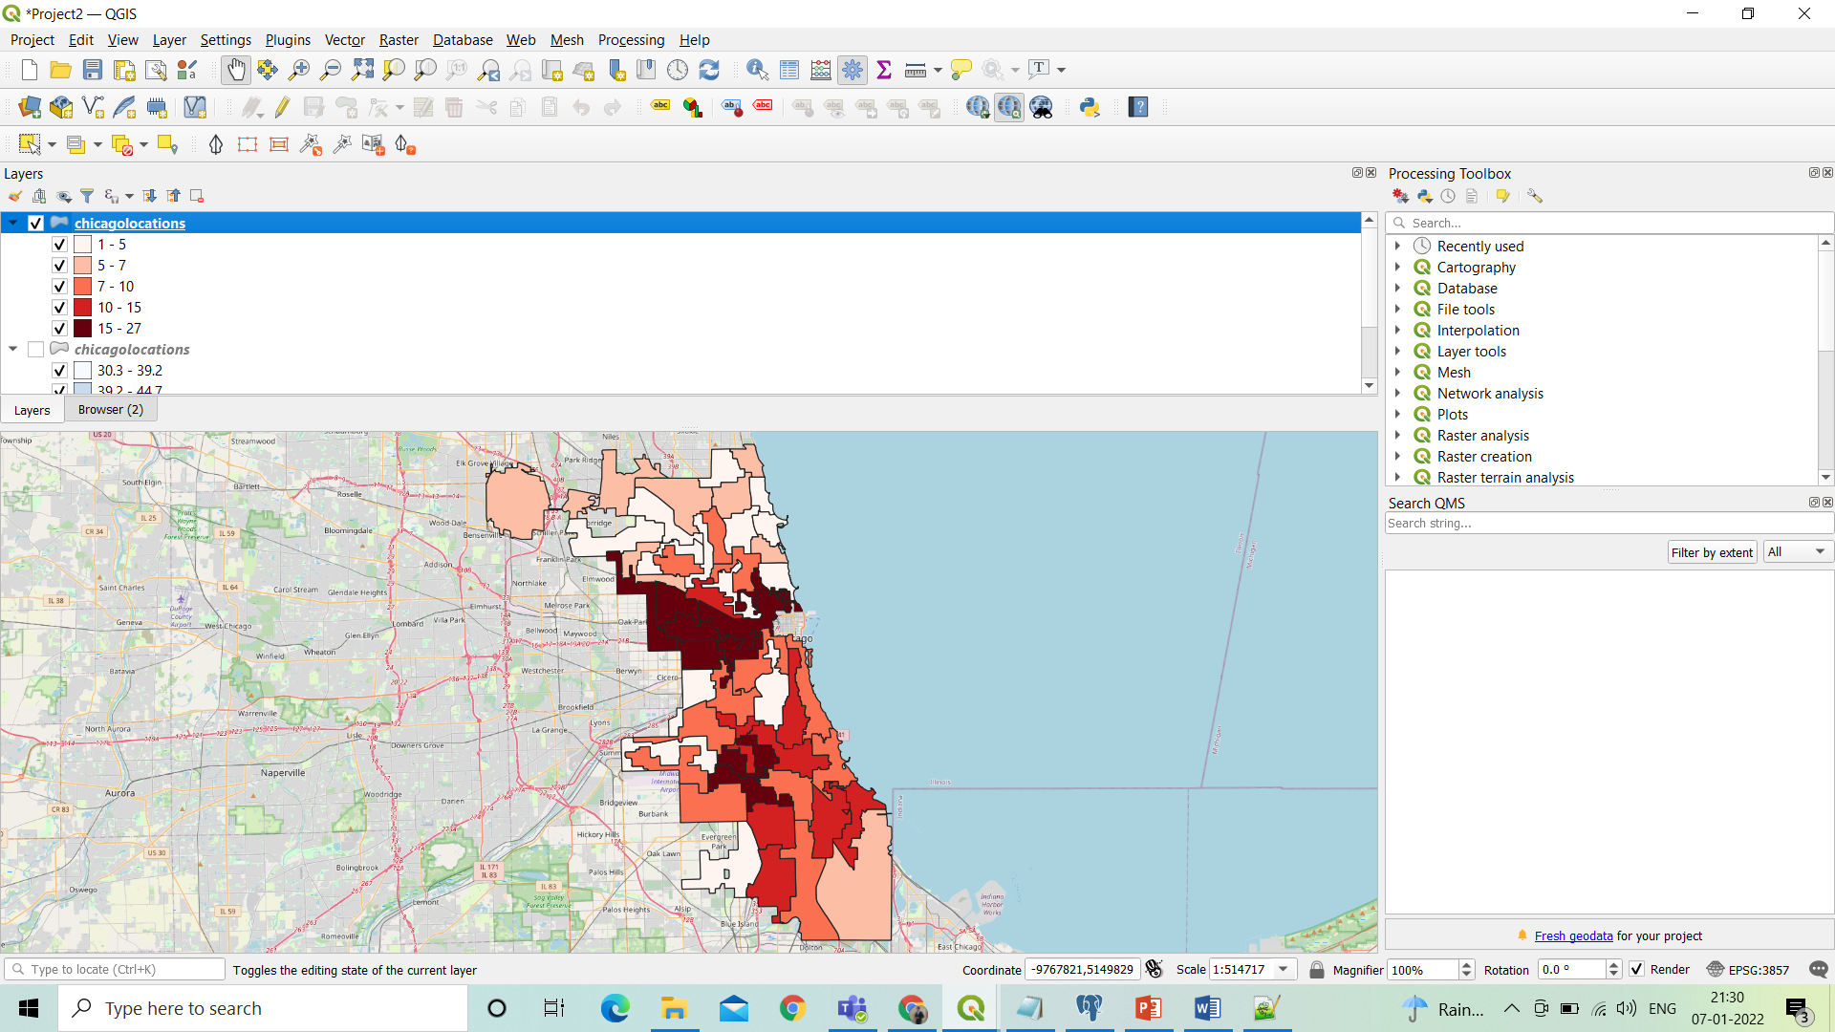
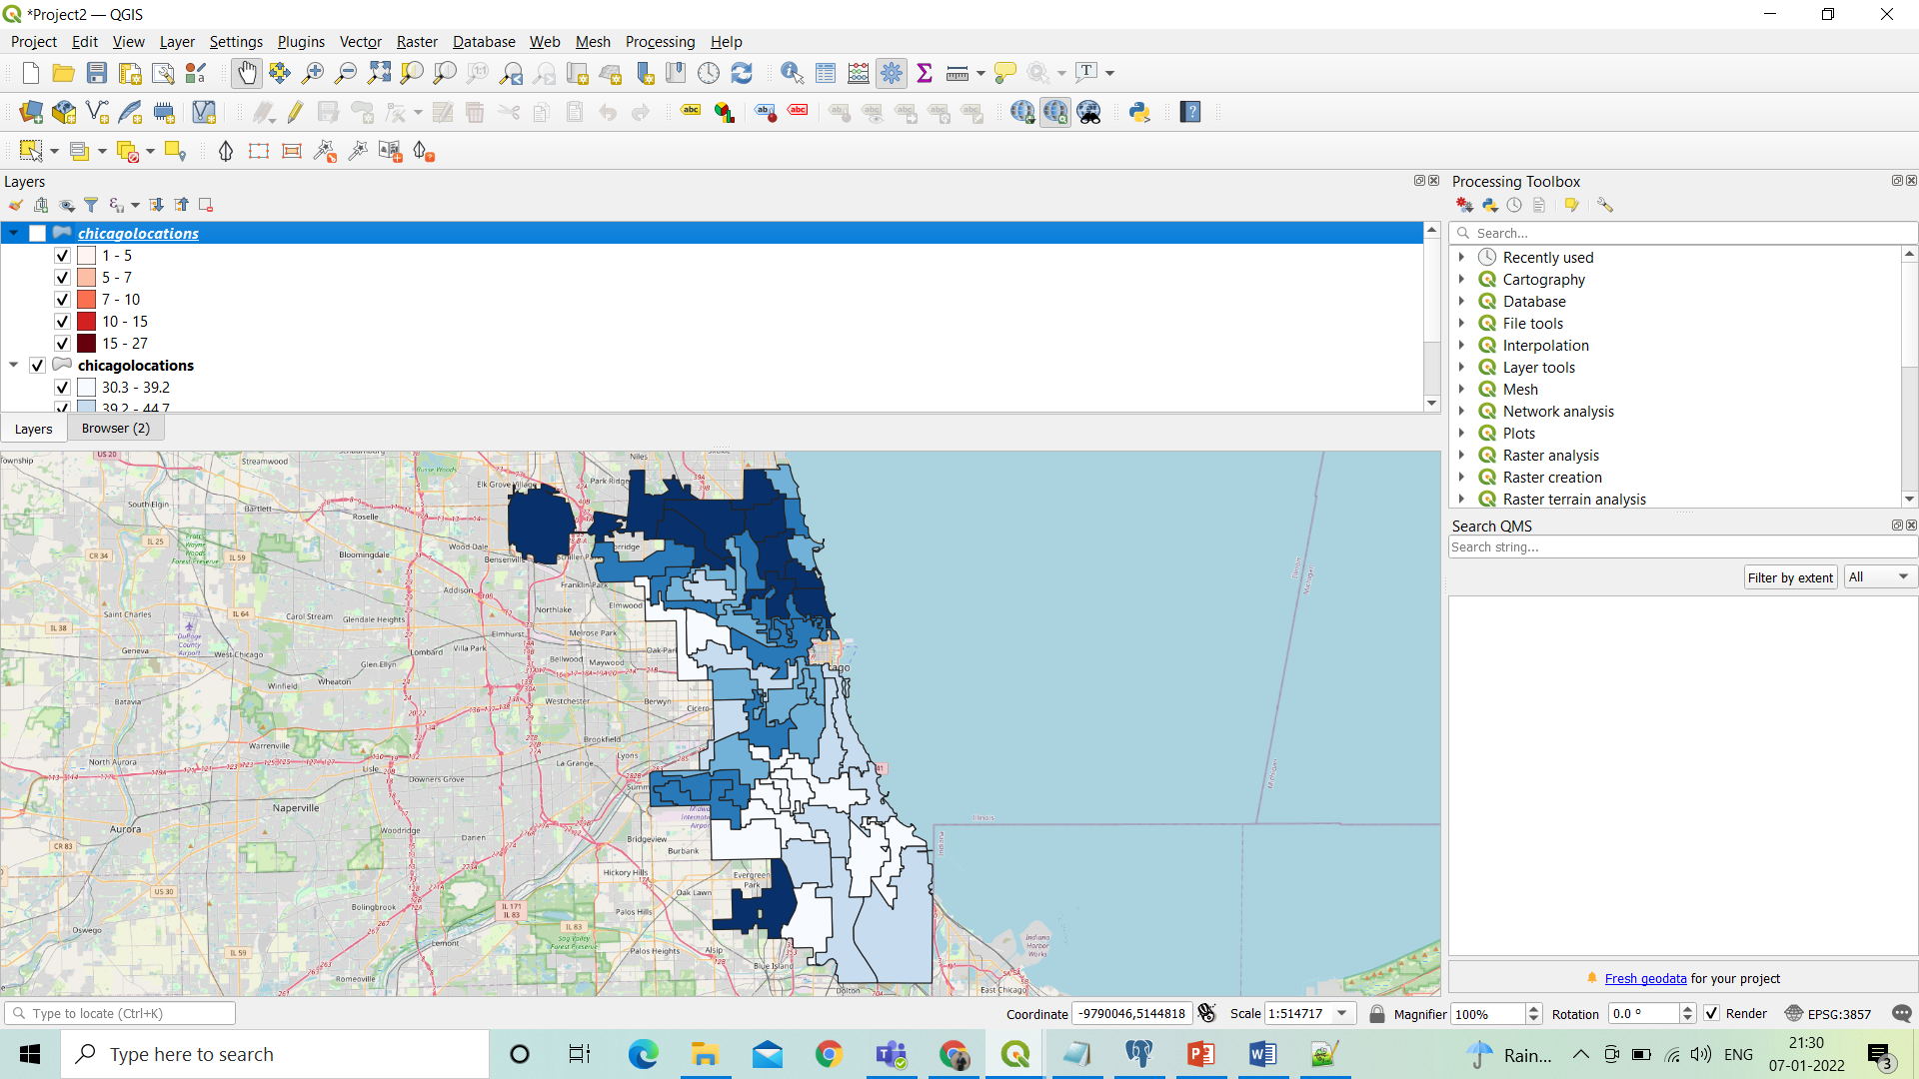
Choropleth Map for Crimes per ward and Safety Scores of schools per ward.
Crimes per ward
Safety Scores of schools per ward.

Slide 16
Conclusion
We believe this project give us a scientific view about the safety score and crimes in Chicago city.
Analyzed frequent crimes at frequent locations.
Analyzed safety scores for different wards.
Major concern is the arrest rate, which is less than 50%.

Slide 17
References
Chicago Dataset I downloaded from below mentioned links.
CHICAGO_PUBLIC_SCHOOLS https://ibm.box.com/shared/static/f9gjvj1gjmxxzycdhplzt01qtz0s7ew7.csv
CHICAGO_CRIME_DATA: https://ibm.box.com/shared/static/svflyugsr9zbqy5bmowgswqemfpm1x7f.csv

Slide 18
Thank You!

